Slide 1
UNIT - 2
RELATIONAL ALGEBRA AND CALCULUS

Slide 2
RELATIONAL ALGEBRA
Queries in relational algebra are composed using a collection of operators, and each query describes a step-by-step procedure for computing the desired answer; that is, queries are specified in an operational manner.

Slide 3
Why RELATIONAL ALGEBRA?
In defining relational algebra and calculus, the alternative of referring to fields by position is more convenient than referring to fields by name: Queries often involve the computation of intermediate results, which are themselves relation instances, and if we use field names to refer to fields, the definition of query language constructs must specify the names of fields for all intermediate relation instances. This can be tedious and is really a secondary issue because we can refer to fields by position anyway. On the other hand, field names make queries more readable.

Slide 4
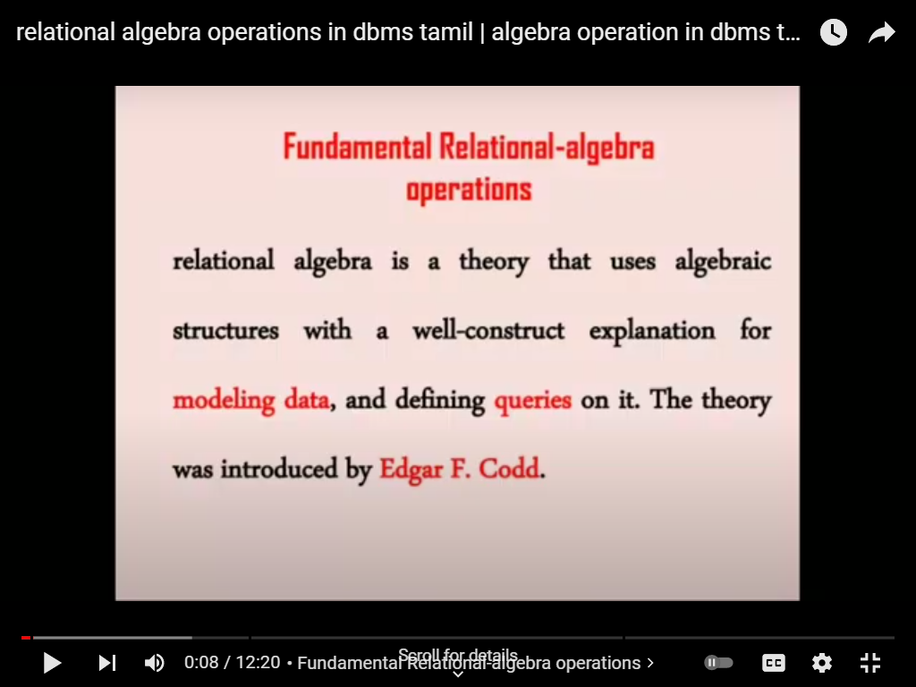
In defining relational algebra and calculus, the alternative of referring to fields by position is more convenient than referring to fields by name: Queries often involve the computation of intermediate results, which are themselves relation instances, and if we use field names to refer to fields, the definition of query language constructs must specify the names of fields for all intermediate relation instances. This can be tedious and is really a secondary issue because we can refer to fields by position anyway. On the other hand, field names make queries more readable.

Slide 5
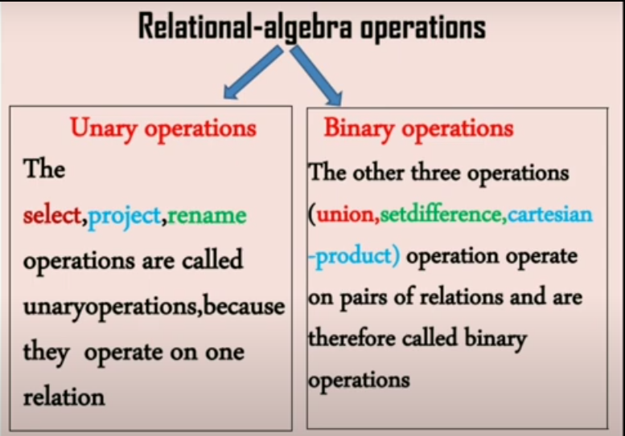

Slide 6
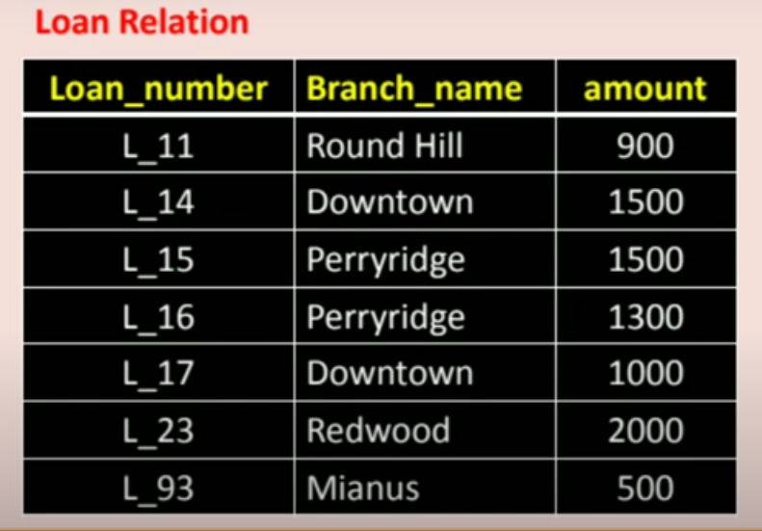

Slide 7
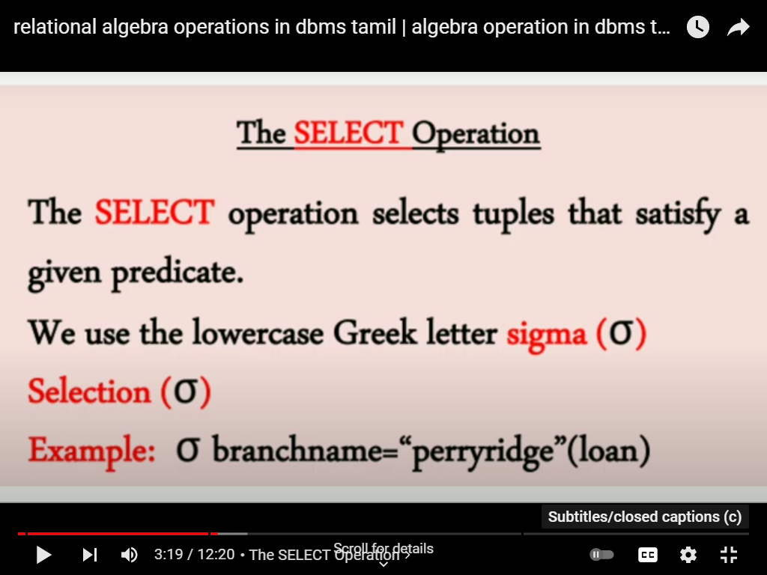

Slide 8
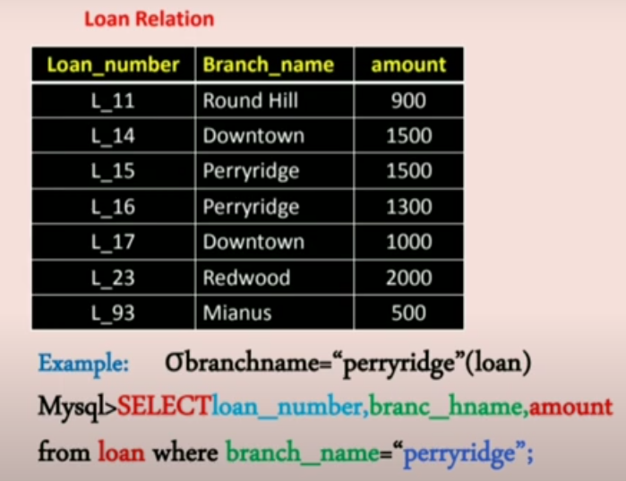

Slide 9
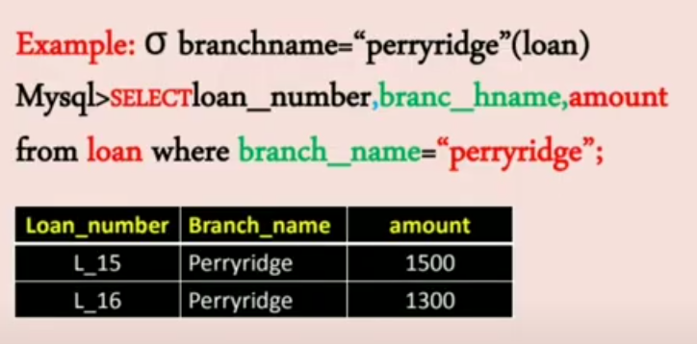

Slide 10
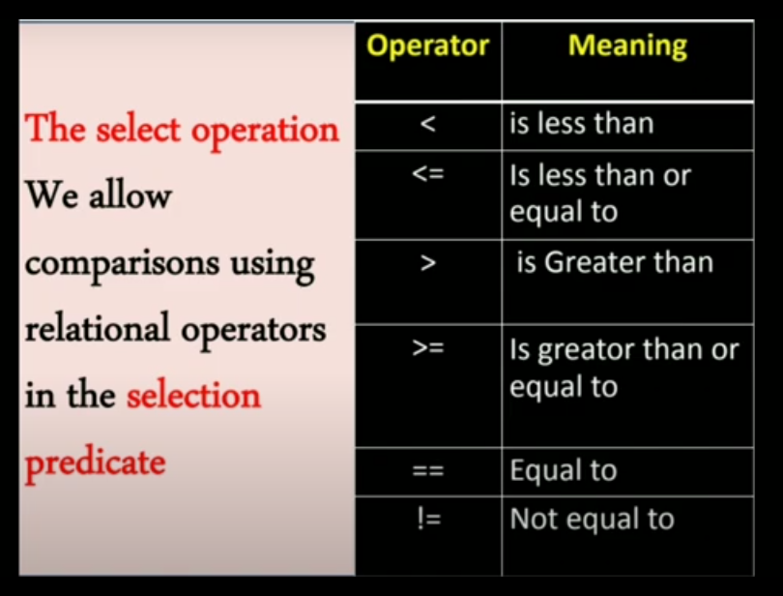

Slide 11
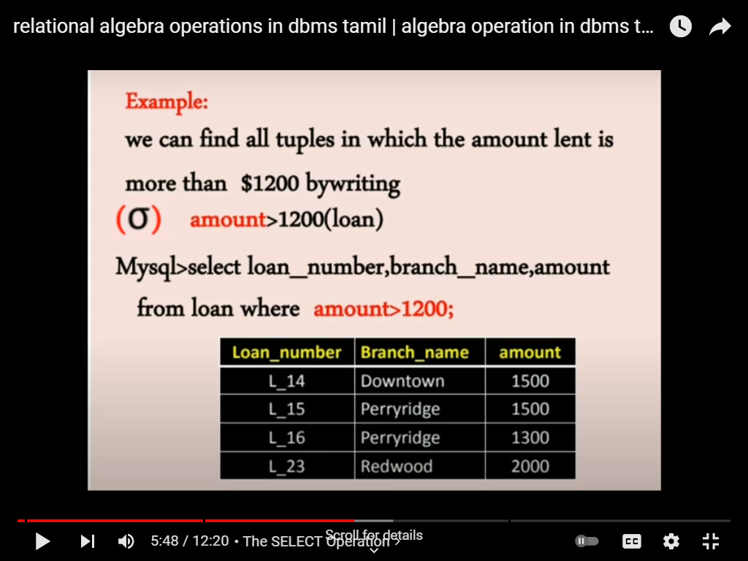

Slide 12
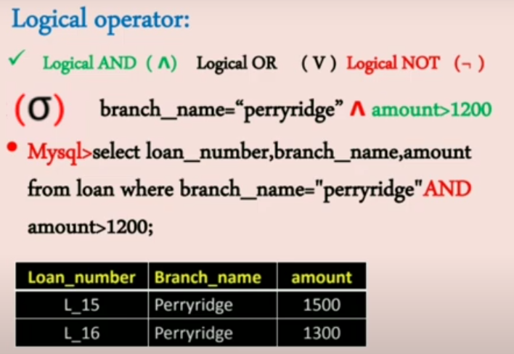

Slide 13
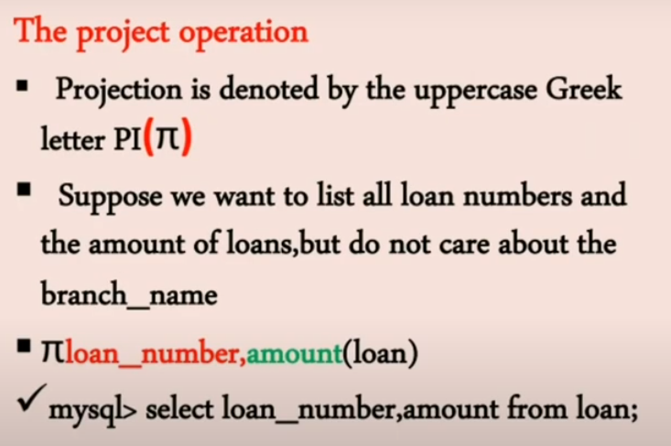

Slide 14
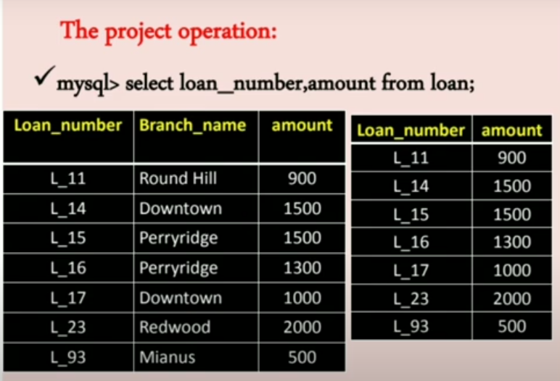

Slide 15
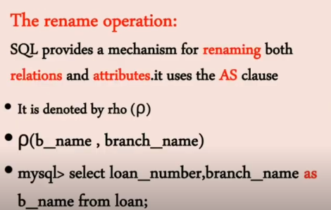

Slide 16
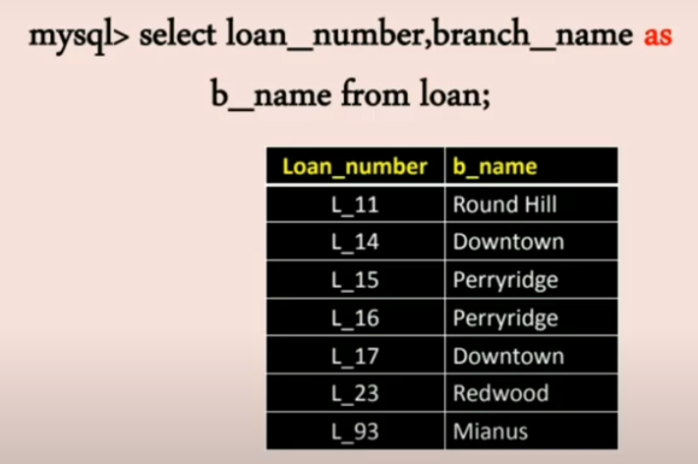

Slide 17
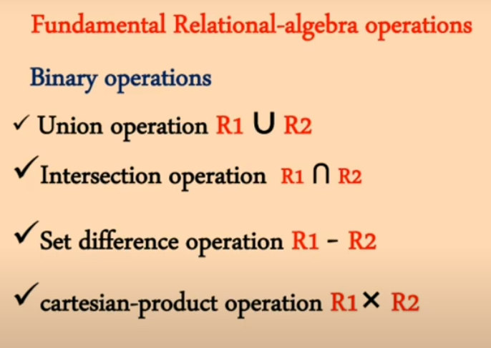

Slide 18
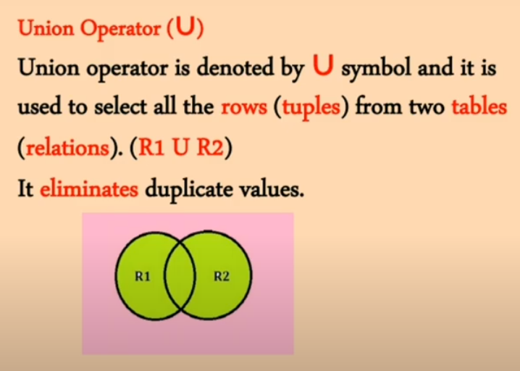

Slide 19
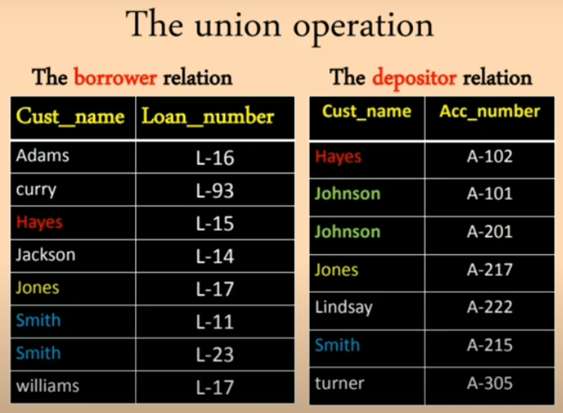

Slide 20
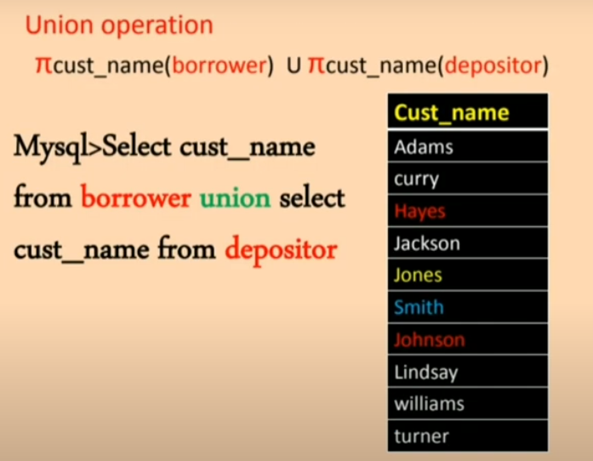

Slide 21
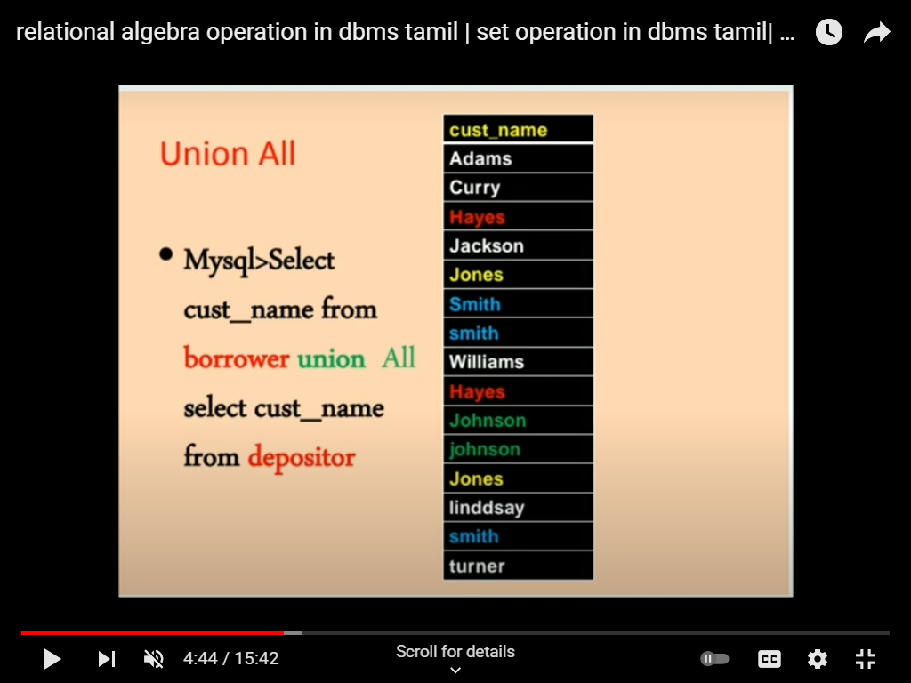

Slide 22
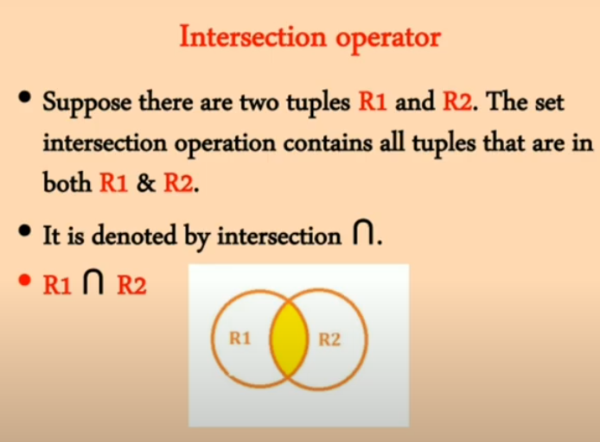

Slide 23
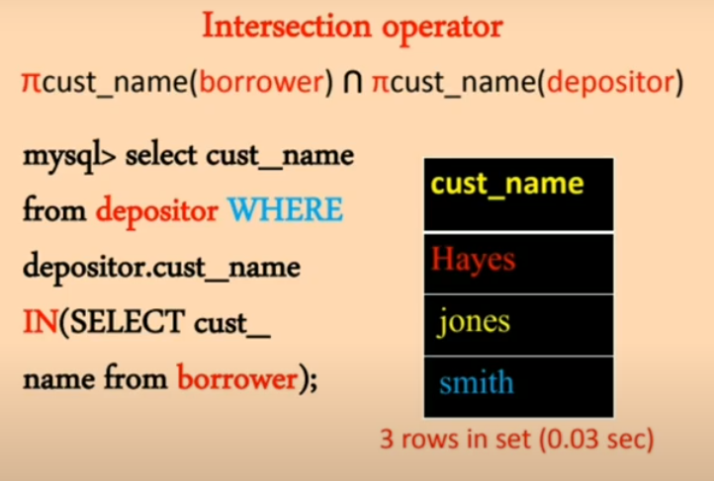

Slide 24
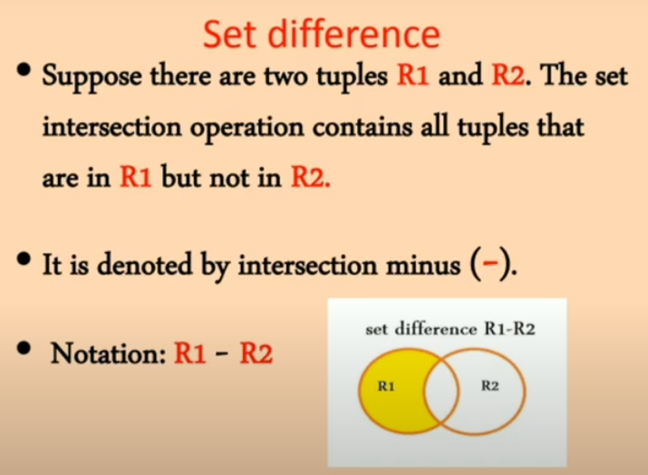

Slide 25
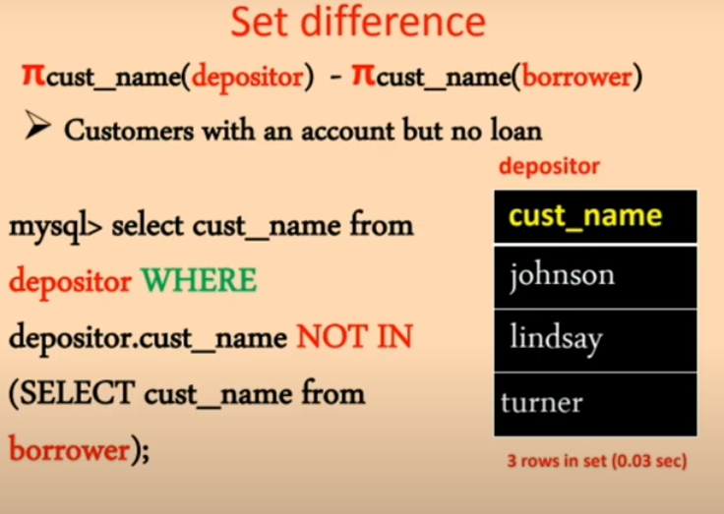

Slide 26
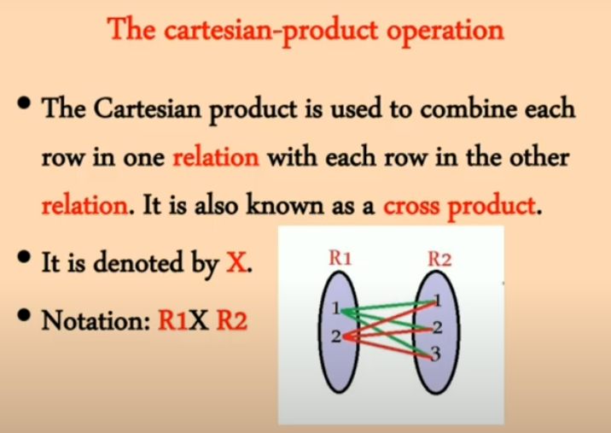

Slide 27
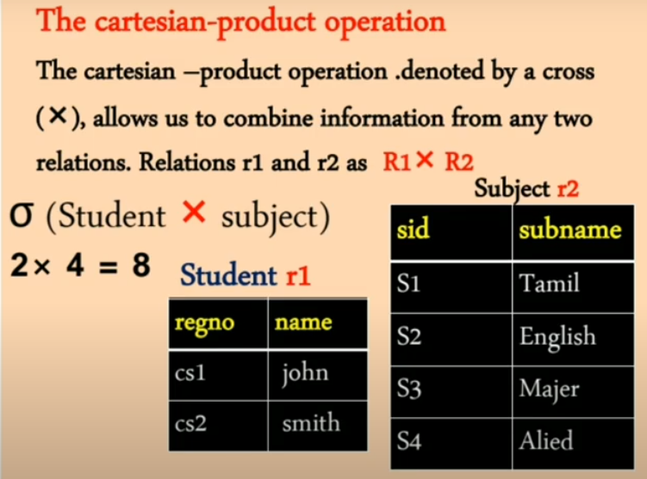

Slide 28
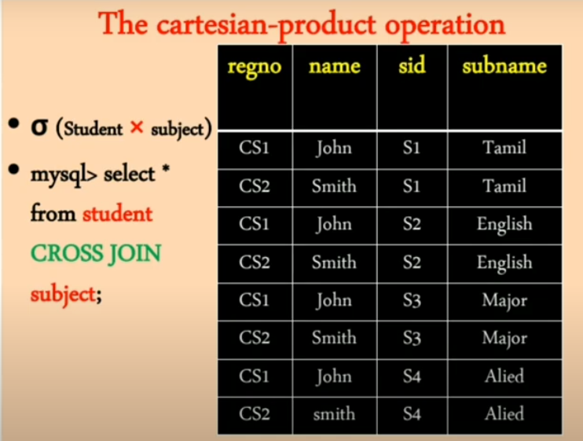

Slide 29
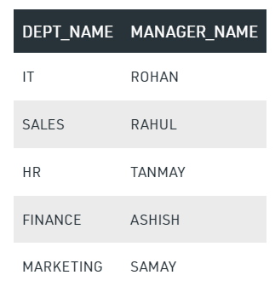
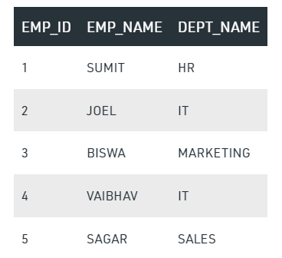
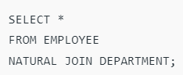
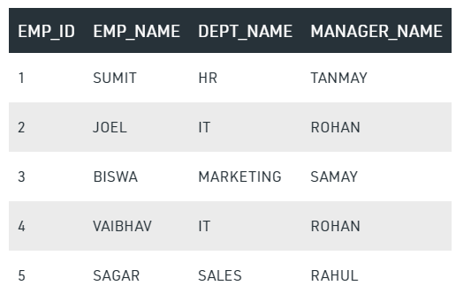

Slide 30
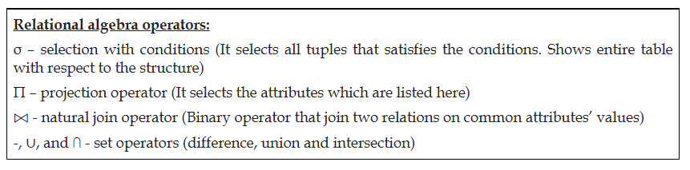

Slide 31
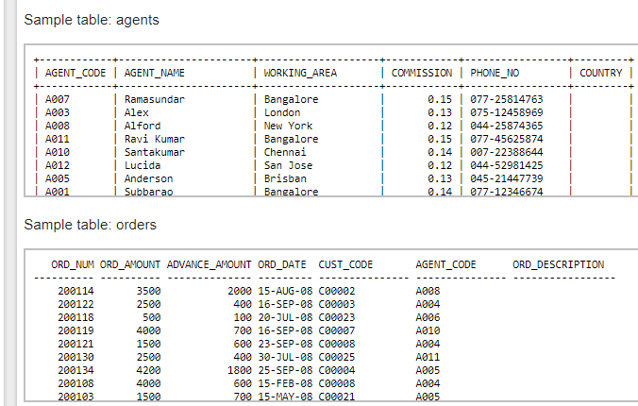

Slide 32
Query 1:
in the outer query:
'agent_code' of 'orders' table must be in the list within IN operator in inner query :
in inner query:
'working_area' of 'agents' table must be 'Bangalore',

Slide 33
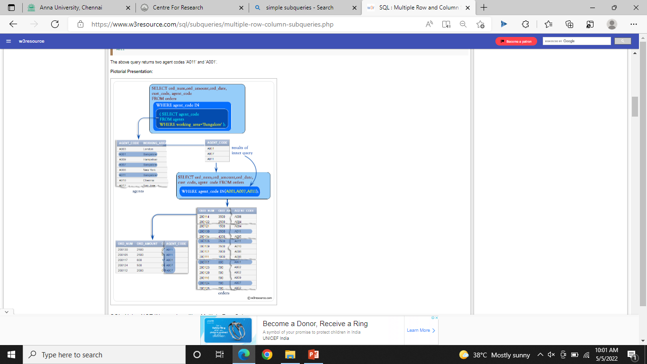
Query 1: Answer
SELECT ord_num,ord_amount,ord_date, cust_code, agent_code FROM orders WHERE agent_code IN( SELECT agent_code FROM agents WHERE working_area='Bangalore');

Slide 34
Correlated Subqueries
SQL Correlated Subqueries are used to select data from a table referenced in the outer query. The subquery is known as a correlated because the subquery is related to the outer query. In this type of queries, a table alias (also called a correlation name) must be used to specify which table reference is to be used.
The alias is the pet name of a table which is brought about by putting directly after the table name in the FROM clause. This is suitable when anybody wants to obtain information from two separate tables.

Slide 35
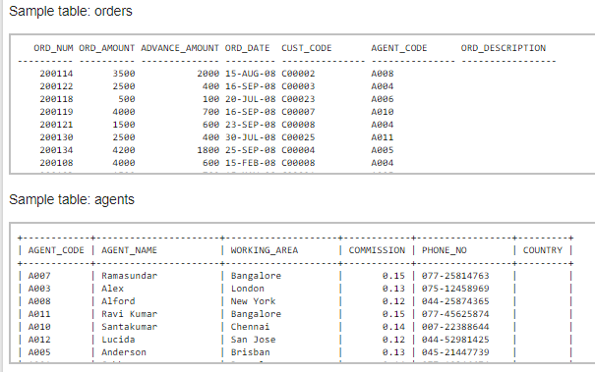

Slide 36
Query 1-Answer
List all the details from order table where agent name is “ALEX” in agent table.

Slide 37
Query 1-Answer
SELECT a.ord_num,a.ord_amount,a.cust_code,a.agent_code FROM orders a WHERE a.agent_code=( SELECT b.agent_code FROM agents b WHERE b.agent_name='Alex');

Slide 38
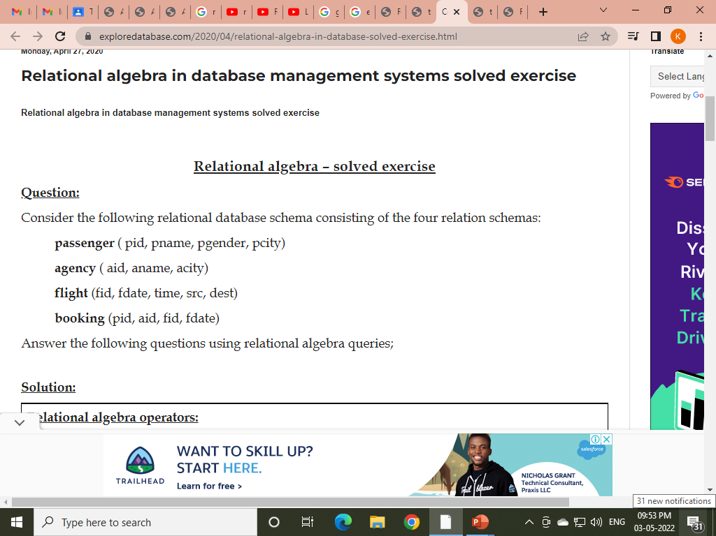

Slide 39
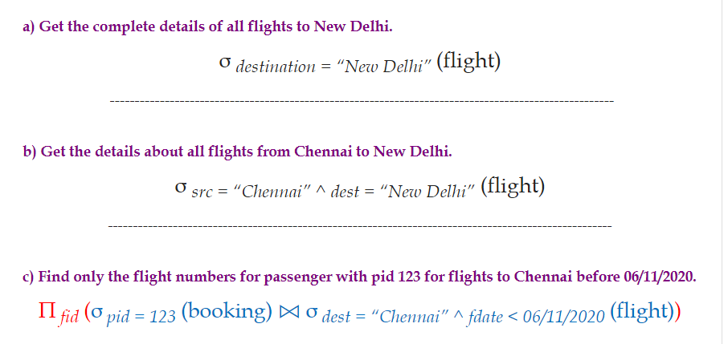

Slide 40
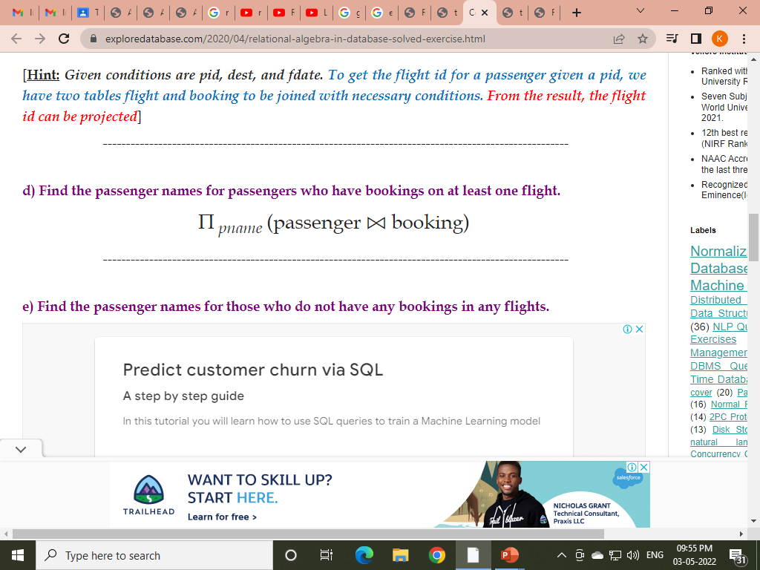
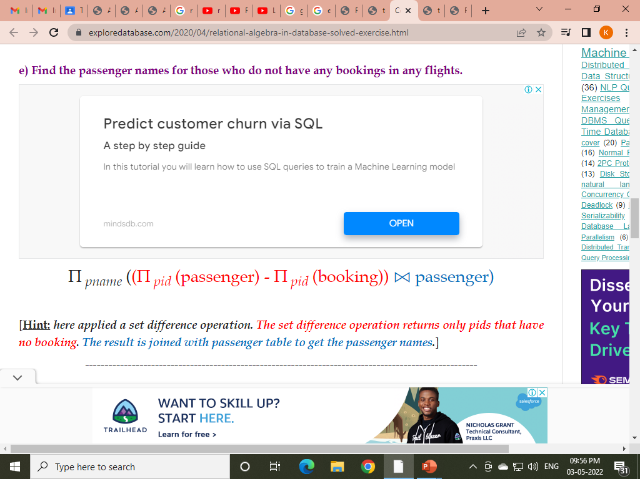
[Hint: Given conditions are pid, dest, and fdate. To get the flight id for a passenger given a pid, we have two tables flight and booking to be joined with necessary conditions. From the result, the flight id can be projected]

Slide 41
[Hint: here applied a set difference operation. The set difference operation returns only pids that have no booking. The result is joined with passenger table to get the passenger names.]
f) Find the agency names for agencies that located in the same city as passenger with passenger id 123.
Π _{aname} (agency ⨝ _{acity = pcity} (σ _{pid = 123} (passenger)))
[Hint: we performed a theta join on equality conditions (equi join) here. This is done between details of passenger 123 and the agency table to get the valid records where the city values are same. From the results, aname is projected.]
g) Get the details of flights that are scheduled on both dates 01/12/2020 and 02/12/2020 at 16:00 hours.
(σ fdate = 01/12/2020 ^ time = 16:00 (flight)) ∩ (σ fdate = 02/12/2020 ^ time = 16:00 (flight))
[

Slide 42
[Hint: the requirement is for flight details for both dates in common. Hence, set intersection is used between the temporary relations generated from application of various conditions.]
h) Get the details of flights that are scheduled on either of the dates 01/12/2020 or 02/12/2020 or both at 16:00 hours.
(σ fdate = 01/12/2020 ^ time = 16:00 (flight)) ∪ (σ fdate = 02/12/2020 ^ time = 16:00 (flight))
i) Find the agency names for agencies who do not have any bookings for passenger with id 123.
Π _{aname} (agency ⨝ (Π _{aid} (agency) – Π _{aid} (σ _{pid = 123} (booking)))
j) Find the details of all male passengers who are associated with Jet agency.
Π _{passengers.pid, pname, pcity} (σ _{pgender = “Male”} (passengers ⨝ booking ⨝ agency))
[Hint: To get the link between passengers and agency, we need to join all three tables passengers, booking, and agency with necessary condition. Here, agency links both passengers and agency. As we have performed natural join operation between all three tables, the degree of the result will consist of all attributes from all the three tables. Hence, we project only passengers details as these are mentioned as required.]

